Slide 1

Integrative Biomedical Research Design Patterns, HPC, Semantic Interoperability and Grid
Joel Saltz, MD PhD
Director Center for Comprehensive Informatics
Emory University

Slide 2



Biomedical Informatics Consortia
What are these guys up to anyway?

Slide 3
Example: caBIG Organization Structure
caBIG Oversight
General Contractor
Integrative Cancer Research
Tissue Banks & Pathology Tools
Imaging
Clinical Trials
Architecture
Open to all, not just funded participants.
190 institutions, 2000 people involved thus far.
Vocabulary & Common Data Elements
Strategic Working Groups
Notes:
Workspace/Project Level Management – Workspace Managers, Project Managers
Each Workspace will be overseen by a Workspace Manager who will be responsible for overall budget, contracts and scheduling. Within a Workspace, individual project teams will be led by Project Managers, most of whom will be members of the Cancer Center community. Project Managers will be required to comply with management and reporting standards and processes according to agreed caBIG policy.
Intermediate Level Management – Master Contractor
A Master Contractor will be engaged to oversee the operational aspects of the caBIG pilot – including the activities of Workspaces and Working Groups. They will provide funding to Centers via subcontract mechanisms. Individual managers to oversee the operation of each Workspace will be appointed by the Master Contractor. The Master Contractor will be directly accountable to the caBIG oversight structure.
Governance Level Management – caBIG Oversight Board
The Oversight Board will be led by NCICB and NCI senior leadership and will provide strategic and programmatic guidance for the initiative as a whole, with the support and guidance of strategic level planning groups composed of members of the Cancer Center Community. The caBIG Oversight Board will be the final arbiter of all caBIG pilot activities and decisions and will follow processes and procedures consistent with government contract management standards.

Slide 4
“Big” Design Patterns for Translational Research
  Deep Integrative Analyses
  Multiscale Investigations that encompass genomics, epigenetics, (micro)anatomic structure and function

Slide 5
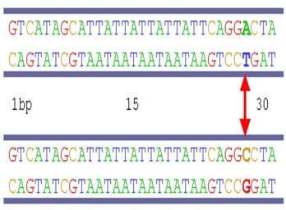

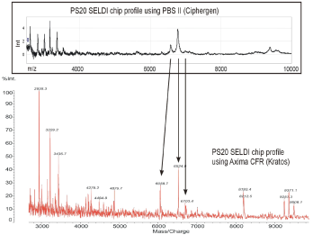
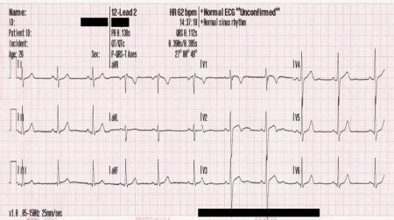
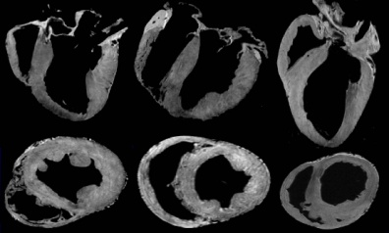
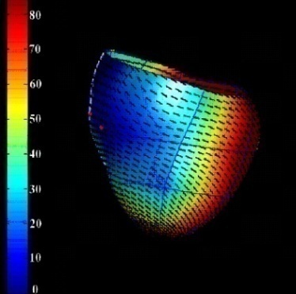
The Reynolds Study
Prospective clinical research study – Deep Integrative Clinical Analysis
Large subject cohort (~ 1,200) at high risk for sudden cardiac death
All have:
  CAD
  LV dysfunction
  received ICD placement
Multi-scale data from each patient
Challenge – discover biomarkers predictive of high risk
Test biomarkers on novel (currently ~500) subject population
Genetic Variability
Gene Expression
Profiling
Protein Expression
Profiling
Electrophysiological
Data
Multi-Modal
Imaging
Data Analysis
And Modeling

Slide 6
Data Analysis and Exploration: Multi-Scale Cardiovascular Data
Investigate genotype-phenotype characteristics among a subset of patients in the Reynolds study
Combine features across different levels of biological organization
  SNP
  mRNA
  Protein
  Imaging
  Electrophysiology
  (ECG)
  Clinical
ECG Data
SNP Data
Image Data
Protein Data
Clinical Data
Analyze data
Filter and integrate different
data types

Slide 7
CVRG: Primary Aims
Support collaborative cardiovascular research
  Integrative data analysis using heterogeneous, distributed resources
  Securely share data and analysis methods with collaborators
  Establish common set of services, data sources, vocabulary and common data elements for cardiovascular research community
  Leverage caGrid, caBIGTM, BIRN
  Initial driving application is the Reynolds study -- an example of deep integrative clinical analysis
  PI – Rai Winslow PhD, Center spans Hopkins, Emory, UCSD, Ohio State

Slide 8
Biomedical Informatics Services
Security
Semantic interoperability
Data structure interoperability
Interoperability with existing standards (e.g. HL-7, DICOM)
Ability to compose services to create application
Ability to efficiently invoke HPC services
Efficient and expressive federated query

Slide 9
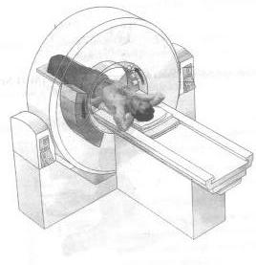
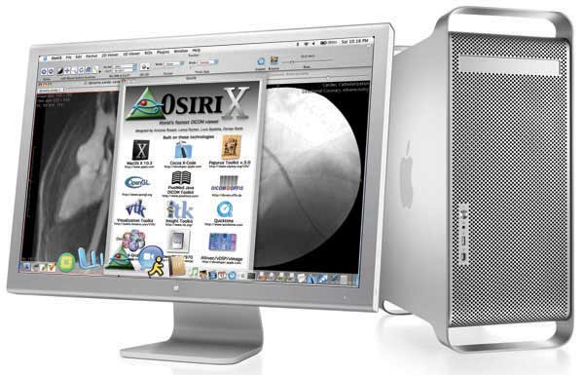
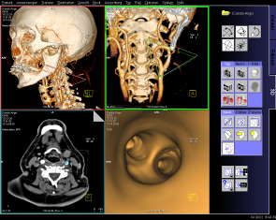
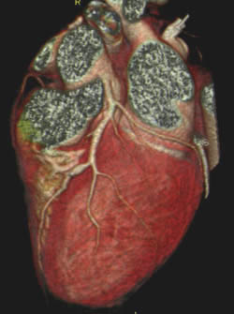
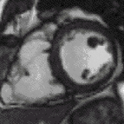
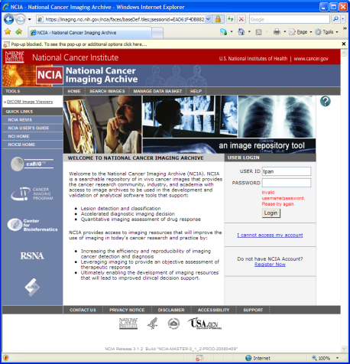
Image Management Workflow
Functional Image Analysis
(Virtual)
PACS
AIM Annotation Database

Slide 10
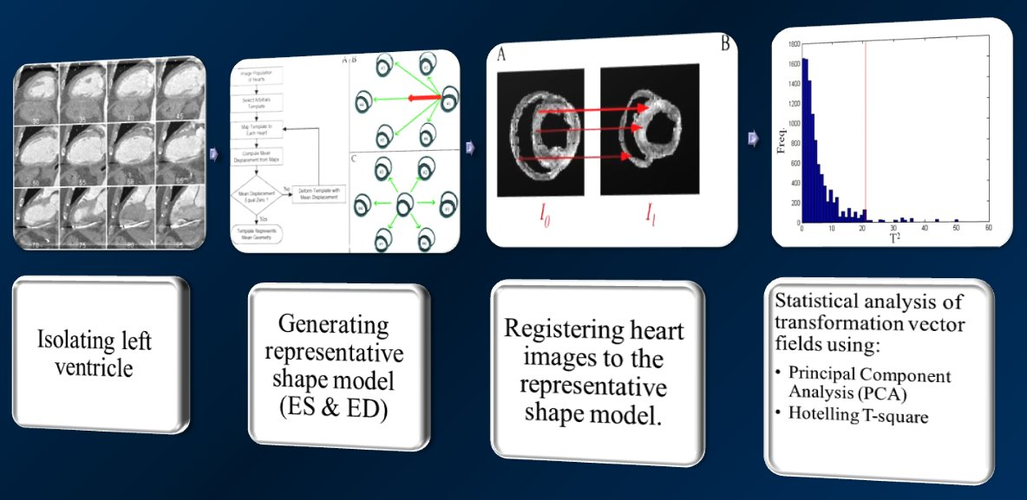
CT Cardiac Shape Analysis Workflow
Heart Images
(Human CT)
Isotropic preprocessing and segmentation to isolate left ventricle.
Affine Registration
Generate Templates for end-systole and end-diastole phases
Register Heart Images to template and perform LDDMM mapping
Statistical Analysis (Principal Component Analysis)
Notes:
10

Slide 11

CALGB INTERSPORE ACRIN NCICB
Investigation of
Serial studies to
Predict
Your
Therapeutic
Response with
Imaging and
And
moLecular analysis
I SPY WITH MY LITTLE EYE . . . . . . . A BIO-MARKER BEGIN-ING WITH X
. . . .

Slide 12
I SPY TRIAL Design
Neoadjuvant Chemotherapy
Surgery
Outcomes
Residual Disease
Recurrence
Serial Core Biopsies
Serial MR Imaging

Slide 13
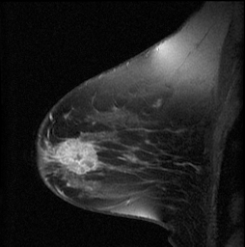
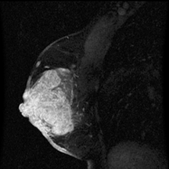
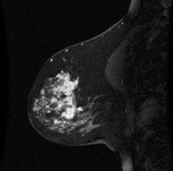
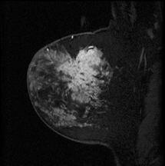
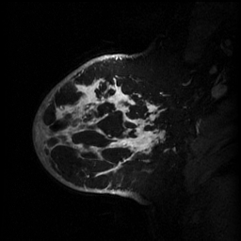
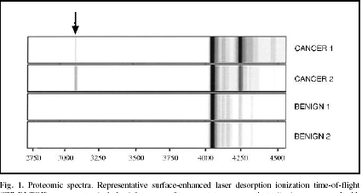
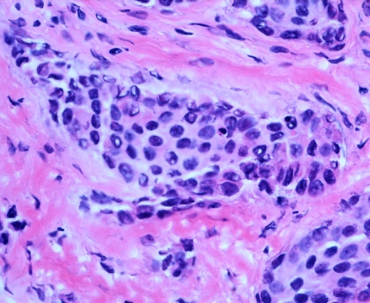
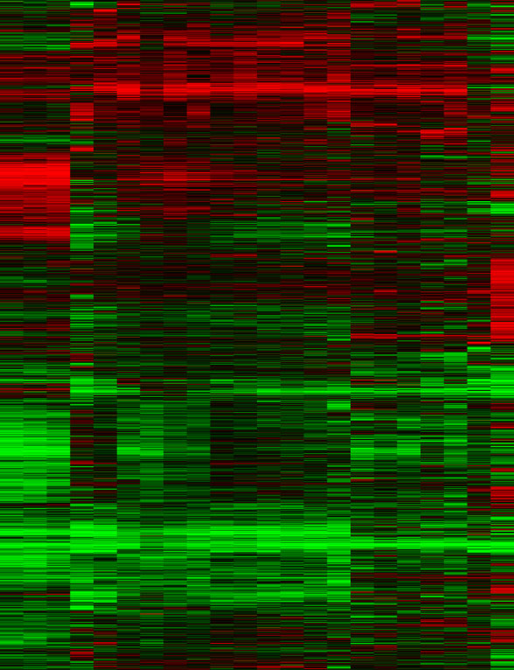
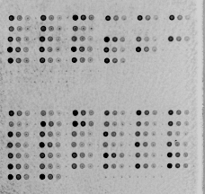
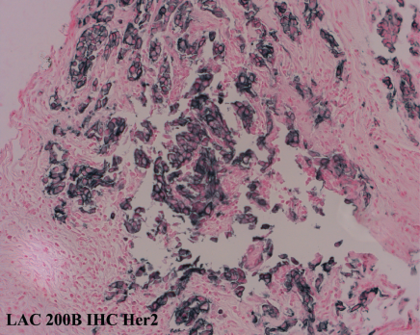
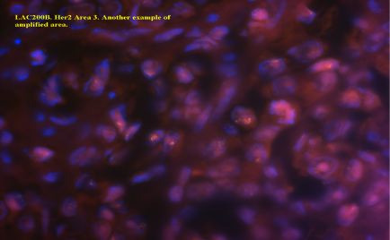
Anthracycline
Taxane
Clinical Study
Surgery
& RT
Tam if ER+
Serum markers, proteomics
MRI
Classification of Morphologic Pattern/Volume Response
Tissue: Core or Surgical
Expression Array
CGH
1q
20q
H&E,IHC,FISH
1p
17p
19p

Slide 14
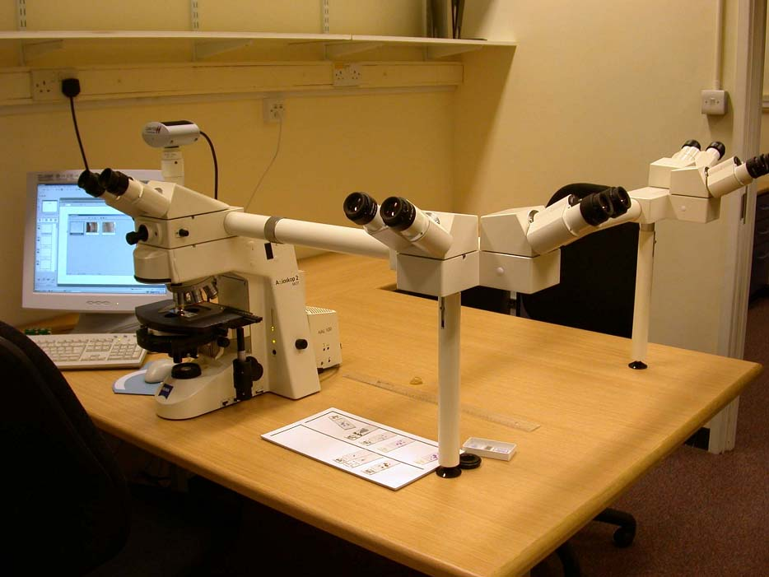
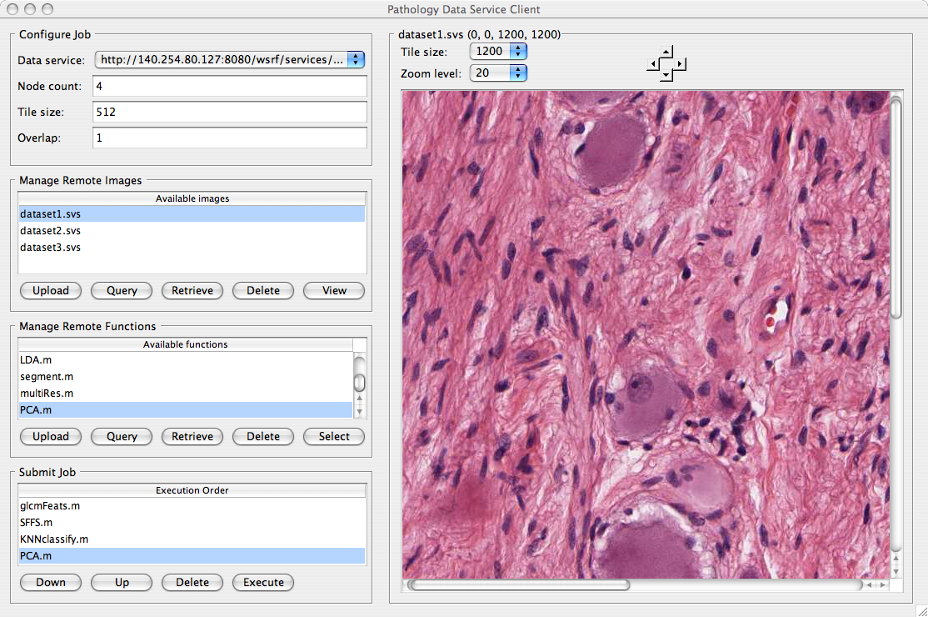
Pathology Coordinated Review
Multiheaded Microscope
caMicroscope

Slide 15
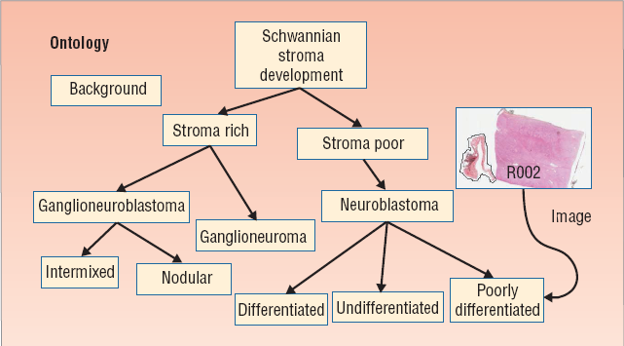
Computer-assisted Histopathology
Analyze images by computer
Analyze the whole tissue, several slides
Provide quantitative information to the pathologist
Reduce inter- and intra-reader variability
Morphological characterization of tissue used for prognosis
Neuroblastoma – Shimada Classification
(Gurcan-OSU, Shimada – LA Children’s)

Slide 16
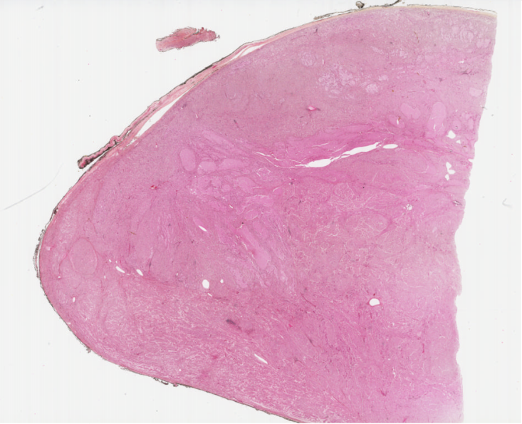
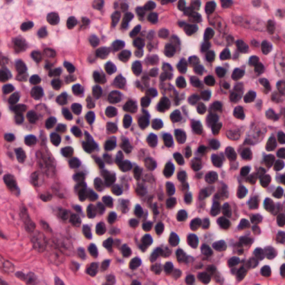
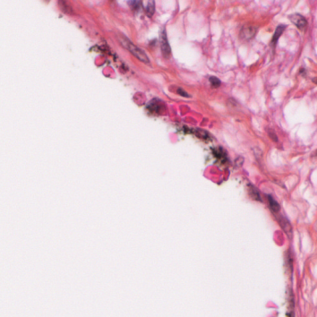
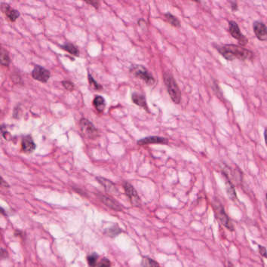
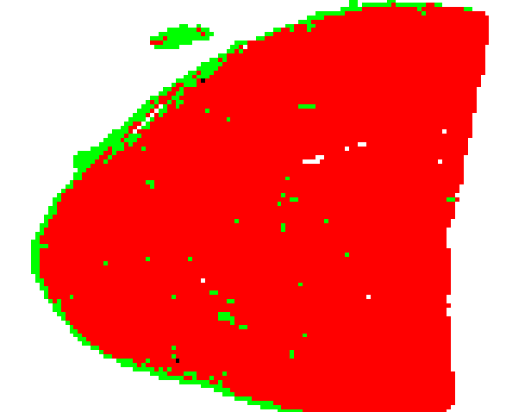
caMicroscope parallel processing caGrid/caOS/DataCutter
Whole-slide image
Image tiles (40X magnification)
`
Parallel Classification
Classification map
Processor 1
Processor N
………
Assign classification labels
Label 1
background
Label 2
undetermined
Hiro Shimada CHLA, Metin Gurcan OSU

Slide 17
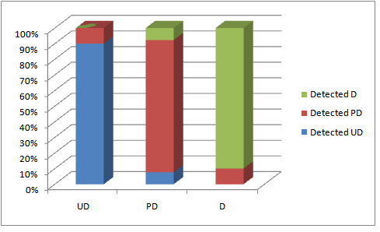
Example Algorithm Results:
Neuroblastoma Grade of Differentiation
UD: Undifferentiating
PD: Partially differentiating
D: Differentiating

Slide 18
Design Pattern Driven Requirements
Semantics: Design template involves deep integration of many types of information to synthesize knowledge
Interoperability: Information drawn from commercial/enterprise systems e.g. health information records, PACS, Lab information systems, as well as genetic, genomic, epigenetic, microscopy databases
HPC requirements arise from many sources: natural language processing, whole genome analyses, coordinated analysis of multiple types of molecular, image data

Slide 19
Design Pattern Driven Requirements
Composition of computationally modest and HPC services – caGrid, caOS, DataCutter
Composition of services written in multiple languages running in varied environments – Wings/Pegasus/Taverna/Introduce/gRAVI
Workflow engines capable of efficient inter-service large scale data transfer, security delegation – New caOS Workflow Engine
Libraries of optimized components/services – GPU/Cell DataCutter libraries for image analysis
Integrated analysis/human review may require soft real time response

Slide 20
Design Pattern Driven Requirements
Flexibility: ability to accommodate different data formats, different semantic classifications
Interoperability: composition of caGrid, myGrid, BIRN, CVRG and unaffiliated web services
Goal of caGrid Roadmap – plug and play workflow scripting environment, service level execution environment, fine grained execution environment
  e.g. Taverna, caGrid, caOS, DataCutter;
  Wings, Pegasus, Condor, DataCutter;
  WEEP, caGRID, MPI

Slide 21
“Big” Design Patterns for Translational Research
  Deep Integrative Analyses
  Multiscale Investigations that encompass genomics, epigenetics, (micro)anatomic structure and function

Slide 22
Tumor Microenvironment
Cancer is a complex phenomenon
A tumor is an organ
Structural and functional differentiation within tumor
Molecular pathways are time and space dependent
“Field effects” – gradient of genetic, epigenetic changes
Experiments to elucidate integrate microscopy, high throughput genetic, genomic, epigenetic studies, flow cytometry, microCT, nanotechologies …
Simulation is next frontier
Tumors are organs consisting of
many interdependent cell types
From John E. Niederhuber, M.D. Director National Cancer Institute, NIH

Slide 23
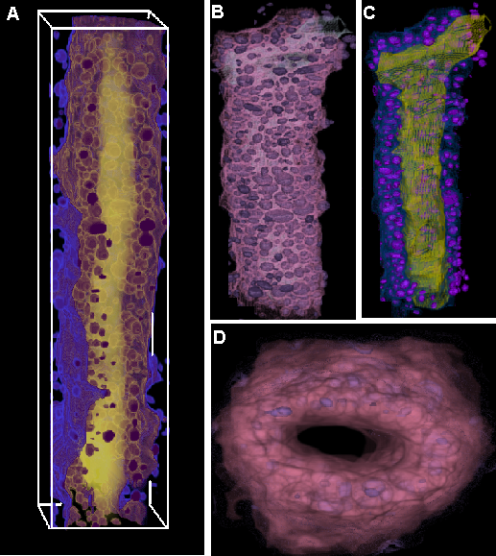
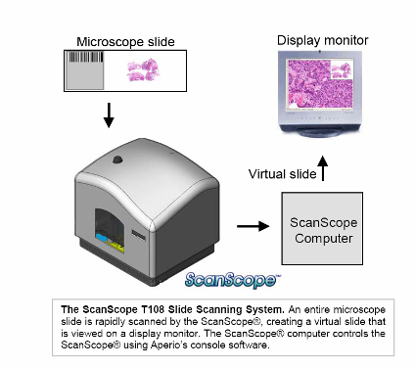
Tumor Microenvironment
Slide Scanning
Ducts
Imaging Team led by Raghu Marchiraju,
Kun Huang OSU

Slide 24
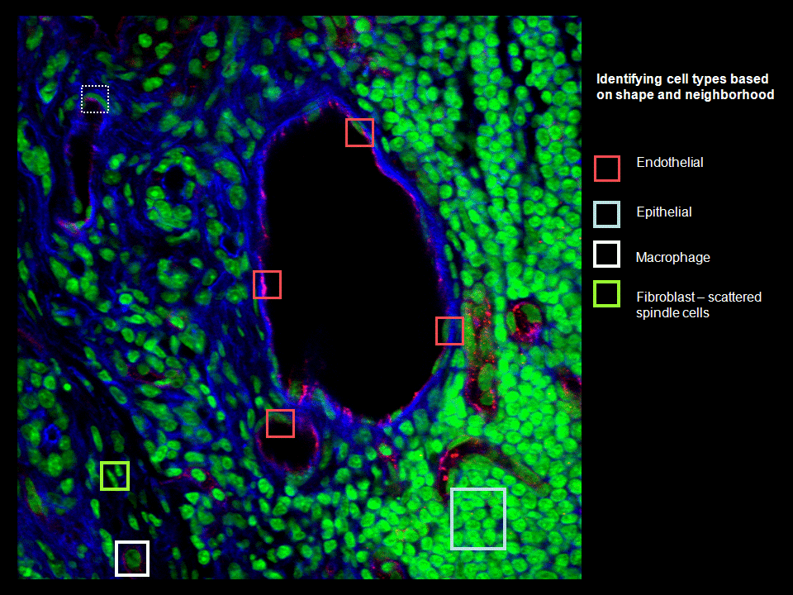
“GIS type service”: Semantic Annotation and Spatial Reasoning
Ontology
Endothelial cells touch blood vessel lumen
Protein C is expressed only in endothelial cells
Instance Data
Region A is a cell (from image analysis)
Region A expresses protein C (from molecular assay)
Region B (from expert markup)
Spatial Rule
touches(Region B, Region A) – algorithmically evaluates to true
Spatial and Ontological Inference
Region A is an endothelial cell
Region B is a blood vessel

Slide 25
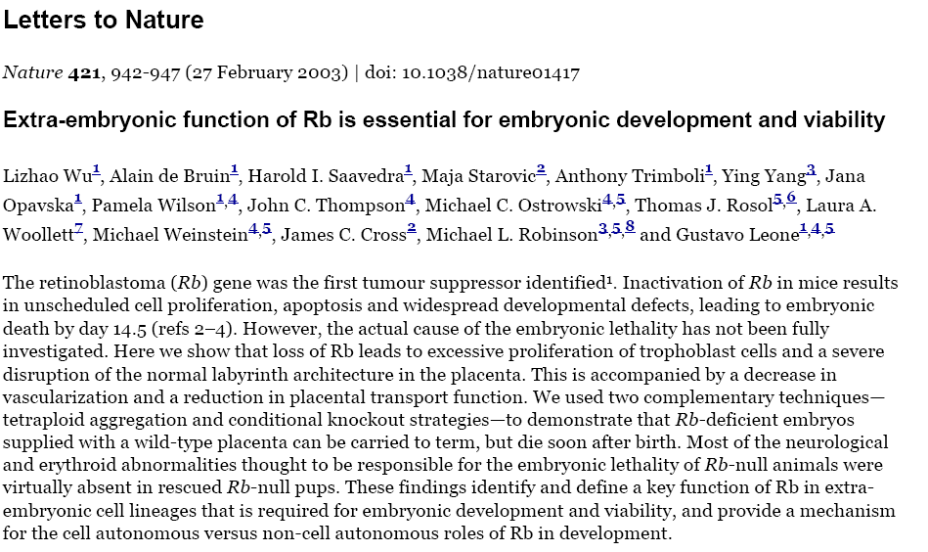
Mouse Placenta: Understand function of Rb gene

Slide 26
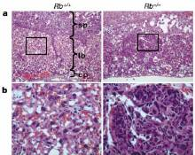
Wild vs Mutant
Wild type - Labyrinth neat, well-ordered, maternal blood sinusoids and trophoblasts evenly dispersed among fetal blood cells.
Mutant - Trophoblasts grow wildly, clump together and disrupt fetal and maternal cells layers necessary for proper embryonic growth

Slide 27
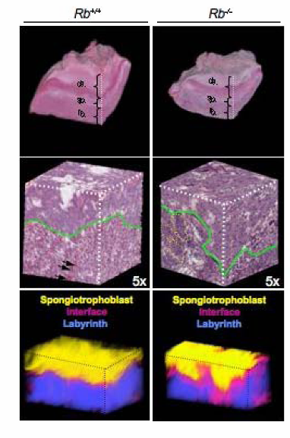
Wild Type vs Mutant: Analysis of Entire Placenta
3-D Reconstruction
Quantitative tissue analysis

Slide 28
Design Pattern Driven Requirements for Multiscale
Complex, hierarchical annotation of microanatomic structures; molecular composition: “ducts, a specific duct, epithelial cells surrounding a specific duct, a particular epithelial cell in the neighborhood of a particular duct, the nucleus of a specific epithelial cell in the neighborhood of a particular duct …”
Spatial/semantic queries: What is the morphological/molecular effect on cell type 1 if we make a genetic change in cell type 2
Algorithm annotation and composition: Interoperability critically dependent on semantic modeling of application domain
Interplay between spatial and molecular data underlies increasing fraction of biomedical research studies – “GIS type” service

Slide 29
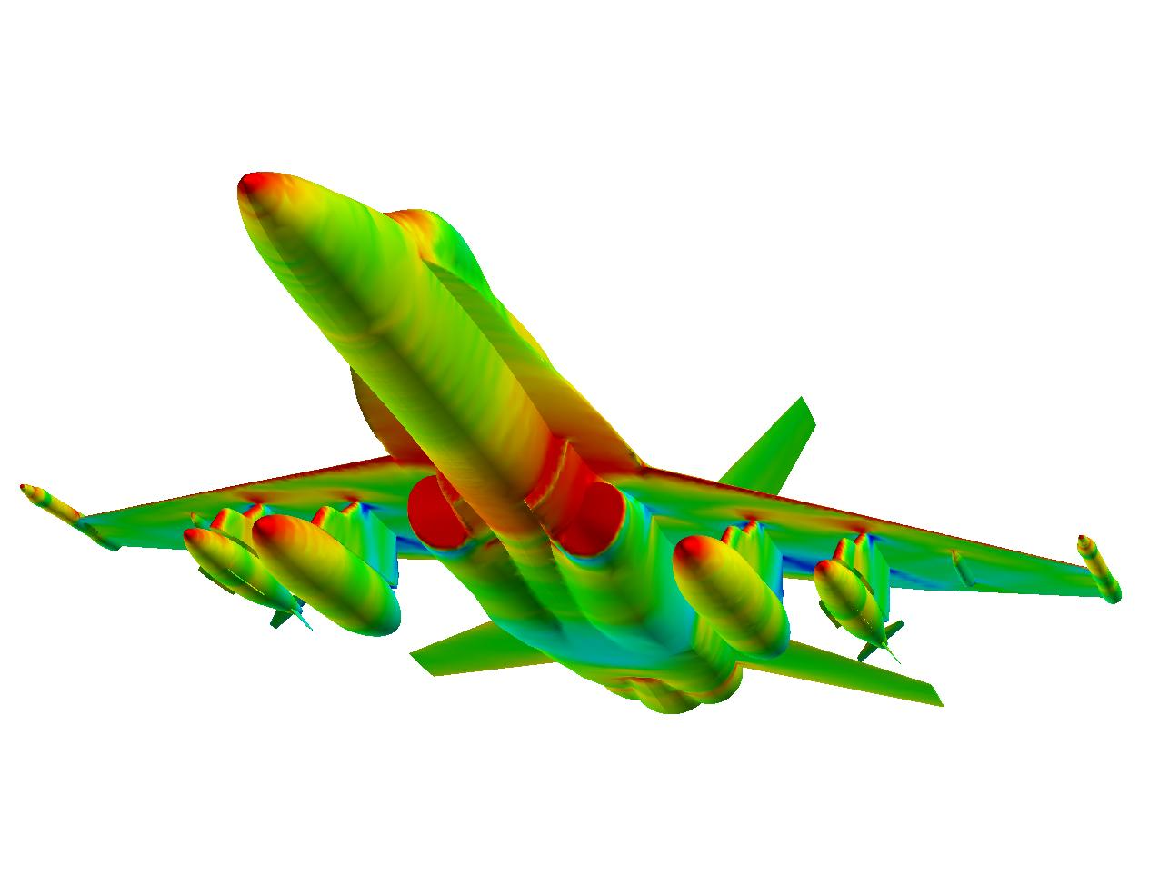
When are we going to get serious about simulation?

Slide 30
caGrid Roadmap planning process
Engage the Computer Science Systems Software Community
Data and Analytic Services – Present and Future
  Easy integration of existing database systems, High-performance Grid Nodes, multi-core systems, on-demand computing, data intensive computing, parallel database and file systems.
Workflows and Orchestration
  Interoperability between different workflow execution environments; hierarchical workflow systems; HPC and large scale data support
Federated Query
  Semantic, federated, spatial query support
Semantic Infrastructure
  Semantic annotations for services, relationship between semantics and data structures, systematic curation vs community freedom, semantic query support.
Security
  Security middleware support for complex organizations, complex workflows. Compliance with regulatory guidelines

Slide 31
Acknowledgments
The caGrid team:caGrid 1.0: Scott Oster, Stephen Langella, Shannon Hastings, David Ervin, Ravi Madduri, Tahsin Kurc, Frank Siebenlist, Ian Foster, Krishnakant Shanbhag, Peter Covitz
The caOS team: Renato Ferreira, Shannon Hastings, Umit Catalyurek
Parameterized workflow project: Mary Hall, Yolanda Gil, Ewa Deelman, Tahsin Kurc, Vijay Kumar, Varun Ratnaker, Jihie Kim
OSU Imaging Algorithm Team: Raghu Machiraju, Metin N. Gurcan Ph. D. , Kun Huang Ph.D, Kishore Mosaliganti, Lee Cooper, Antonio Ruiz, Olcay Sertel
The Imaging Informatics/HPC team: Tony C. Pan M.S., Ashish Sharma Ph.D., Manuel Ujaldon Ph.D. Olcay Sertel Antonio Ruiz, Vijay Kumar Sivaramakrishnan Narayanan,
Umit V. Catalyurek Ph.D
CVRG: Rai Winslow PhD (PI), Project 1 team: Mark Ellisman, Tahsin Kurc, Justin Permar, Steven Granite, Jeff Grethe, Anthony Kolasny, Tony Pan, Justin Permar
Tumor Microenvironment PIs: Mike Ostrowski, Gustavo Leone
Advanced Technology Consortium, QARC, ITC: TJ Fitzgerald, Jim Purdy, Walter Bosch
Eliot Siegel, Paul Mulhorn, Michael McNitt-Gray, all SMEs and participants in the caBIG in-vivo imaging workspace
12 years of virtual microscope: Alan Sussman, Umit Catalyurek, Tahsin Kurc, Henrique Andrade, Renato Ferreira ….
Carole Goble and the myGrid team

Slide 32
caGrid Teragrid Team Members
geWorkbench (Columbia University)
  Christine Hung (ch2514@columbia.edu)
  Kiran Keshav (keshav@c2b2.columbia.edu)
caGrid (Ohio State University)
  Scott Oster (oster@bmi.osu.edu)
  Stephen Langella (langella@bmi.osu.edu)
caGrid/TeraGrid (Argonne National Laboratory)
  Ravi Madduri (madduri@mcs.anl.gov)
TeraGrid (Argonne National Laboratory)
  Stuart Martin (smartin@mcs.anl.gov)
TeraGrid (Texas Advanced Computing Center)
  Stephen Mock (mock@tacc.utexas.edu)
Management
  Aris Floratos (Columbia University)
  Krishnakant Shanbhag (Argonne National Laboratory)
  Michael Keller (Booz Allen Hamilton)
  Patrick McConnell (Duke University)
  Nancy Wilkins-Diehr (San Diego Supercomputer Center)

Slide 33
CVRG Acknowledgements
Department of Biomedical Informatics, The Ohio State University
  Joel Saltz
  Tahsin Kurc
  Justin Permar
  Tony Pan
  Stephen Langella
Center for Research in Biological Systems, University of California, San Diego
  Mark Ellisman
  Jeff Grethe
  Ramil Manansala
Institute for Computational Medicine, Johns Hopkins University
  Raimond L. Winslow
  Michael I. Miller
  J. Tilak Ratnanather
  Stephen J. Granite
  Anthony Kolasny
  Aaron Lucas
  Kyle Reynolds
  Tim Brown
  Bryan Schwam
  David Hopkins

Slide 34
