Slide 1
Accelerators
Light at the end of a tunnel or a Train
John M. Levesque
CTO Office
Director – Cray’s Supercomputing CoE
Cray Inc

Slide 2
Outline
Why do we have accelerators
  Power Savings
    More flops/watt
  Cost Savings
    More flops/$$
Problems with HPL and HPCC
Where are WE going?

Slide 3
What About Power Savings
More things need to be considered than the power required to run the system
  What about the energy required by the code developers

Slide 4
Power Savings
The power used by Roadrunner 2345.5 Kw
However
  The rumored time to code HPL was a year by 20 people. I think this must be high; however, Andy White gave a talk where he stated that a typical application might need 1 man year, so how much energy was required to develop HPL for Roadrunner?

Slide 5

From “The Matrix” we can determine the amount of energy required

Slide 6
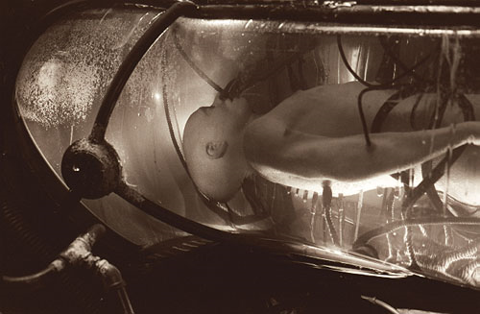
One Man-Year of Energy

Slide 7
From “The Matrix”
From the script:
[Morpheus] "The human generates more bio-electricity than 120-volt
battery and over 25,000 BTUs of body heat. Combined with
a form of fusion, the machines have found all the energy
they would ever need. There are fields...endless fields,
were human beings are no longer born. We are grown. For
longest time, I wouldn't belive it...and then I saw the
fields with my own eyes. Watch them liquefy the dead, so
they could be fed intravenously to the living. And standing
there, facing the pure horrifying precision, I came to
realize the obviousness of the truth. What is The Matrix?
Control. The Matrix is a computer generated dream world,
built to keep us under control in order to change a human
being into this.
[Morpheus holds up a battery to Neo]

Slide 8
Power Savings
The power used by Roadrunner is 2345.5 Kw
However
  The rumored time to code HPL was a year by 20 people. I think this must be high; however, Andy White gave a talk where he stated that a typical application might need 1 man year, so
    The human body generates 25,000 BTU of heat or 2.931 ×10⁻⁴ kWh = 2.931 ×10⁻⁴ *2.5 x 10⁴ * 365 * 8 = 21396 Kw – almost 10 time the system power
Clearly the Energy required to program the Cell is far more than the Energy to run the system

Slide 9
What About Power Savings
More things need to be considered than the power required to run the system
  What about the energy required by the code developers
  What about the energy to run the rest of the computer room

Slide 10

Facilities and Efficiency
Power in a DataCenter
  30-35% to Cooling
    Chillers (This is the BIG HITTER)
    Computer Room Air Conditioner (CRAC) Units
      Typically only 60-80% efficient in extracting heat
    Motors, Fans, Pumps
  10-15% Electrical Losses
    AC→DC conversion
    Inefficiency of systems
  50-60% to the Computer
PUE (Power Usage Effectiveness) Typically PUE=1.8 for most datacenters today.
  PUE = Total Facility Power / IT Power

Slide 11
Cray’s Latest Product Line
Cray’s New Computer Room Chiller

Slide 12
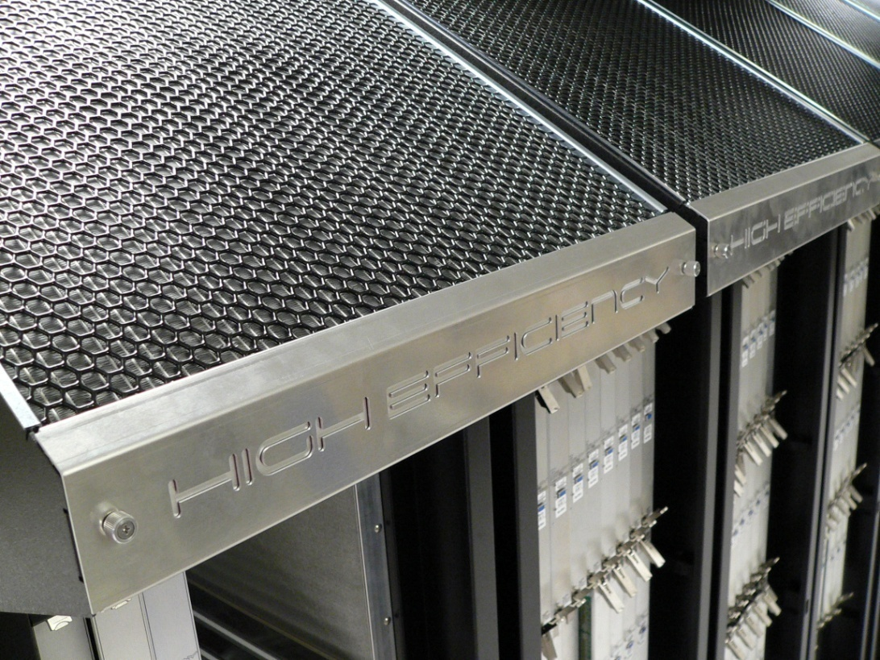
The Cray
High Efficiency Cabinet with ECOphlex Technology
(PHase change Liquid EXchange(PHLEX))

Slide 13
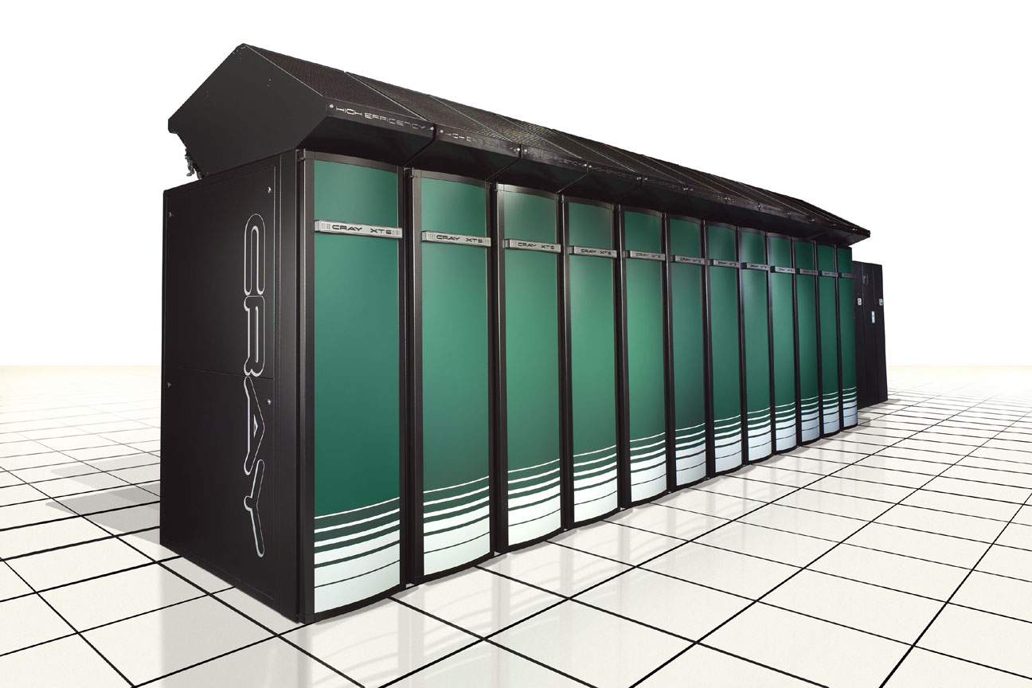
12 HE Cabinet System With XDPs (Front View)

Slide 14
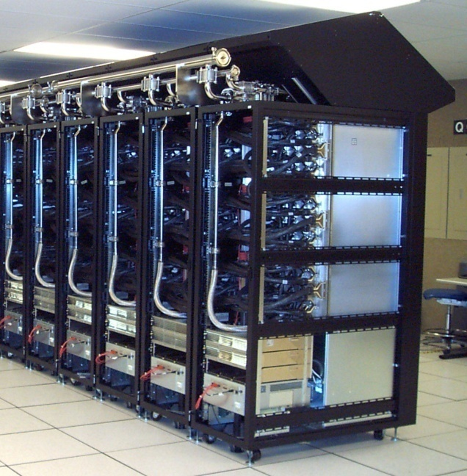
12 HE Cabinet System With XDPs (Rear View)

Slide 15


Slide 16


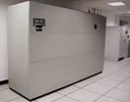
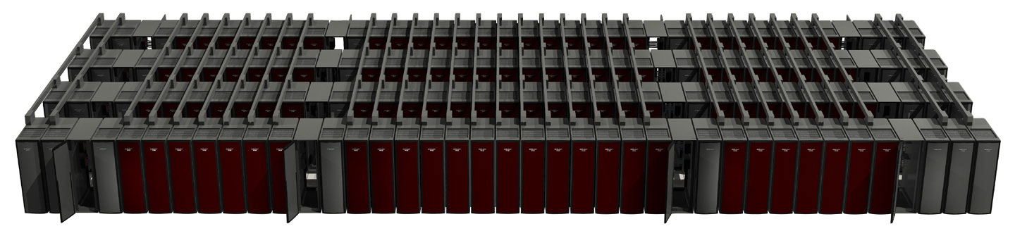
An Air-Cooled SuperComputer Today
Chilled Water to the CRAC Units
Heat
Electricity

Slide 17
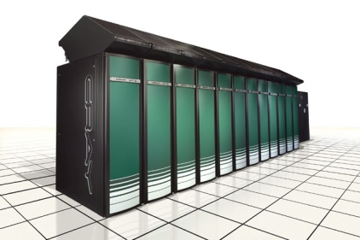
ECOphlex- A Flexible, Efficient Air-Cooled Supercomputer
Chilled Water to the CRAC Units
Heat
Electricity

Slide 18
ECOphlex- A Flexible, Efficient Liquid-Cooled Supercomputer
Water to the XDP
Heat
Electricity

Slide 19

A “Green” Supercomputer
Warm Water Cooling
Heat
Electricity

Slide 20
Cray’s Latest Product Line
And this Chiller comes with a Top 500 Computer
Cray’s New Computer Room Chiller

Slide 21
So what about low power processors?
Some vendors have taken the path of reducing the power and performance of the processor to save on overall power
Cray on the other hand has taken the approach that application developers need the performance to get their science done in a timeframe that is conducive to their research.

Slide 22
So what about low power processors?
Some vendors have also taken the path of reducing the memory of the node to reduce the cost of the system and the overall power
Cray on the other hand has taken the approach that application developers need at least 2GB of memory to get their science done

Slide 23
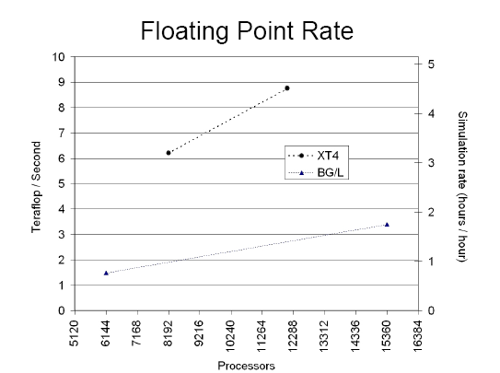
And Since the HPL Number looks at Sustained Performance/Kw
WRF Nature Run by Allan Snavely
XT has four times the memory which uses a significant chunk of the power
XT’s result rate is
3 * 14000/12000 =
3.5 faster
And this is before we add PHLEX liquid cooling
BlueGene’s Power consumption is 1/5 that of XT

Slide 24
And What about Price
Reduction of facility cost with PHLEX
Reduction of programming cost with superior compilation
  The Granite processor in Cascade will be used by Fortran, C and C++ using the Cray Compilation System
And of course the ability to produce Break-through Science is
“priceless”

Slide 25

Pioneering Applications
250 TF Selection Process
ORNL LCF collected data in an open call from science application teams
  Physics models
    What physical models are in your code and what changes are planned in the near future?
  Algorithms
    What algorithms are in your code and what changes are planned in the near future?
  Scaling
    How does your code currently scale and what bottlenecks preclude improved performance?
  If chosen for acceptance
    How might your code be used to test and accept a leadership system?
  If chosen for science on day one
    What science would you explore and what simulations would you do with a 250 TF-month?
  Functional software requirements
    What system software and math libraries are required by your code?
Over 20 application teams delivered written responses
  Broad email requests sent out to user groups
  Predominant response from INCITE, SciDAC, and NSF Projects
  Documented in Appendix E of NCCS 2007 Requirements Document
    Computational Science Requirements for Leadership Computing
  Data delivered in fall 2006 to DOE/ASCR for decision
Pioneering applications for the 1 PF T2O period
  Web-based form available online by 12/31/07; accept applications through Spring 07
  Each application could potentially access 50M hours during the 1 PF T2O period!

Slide 26
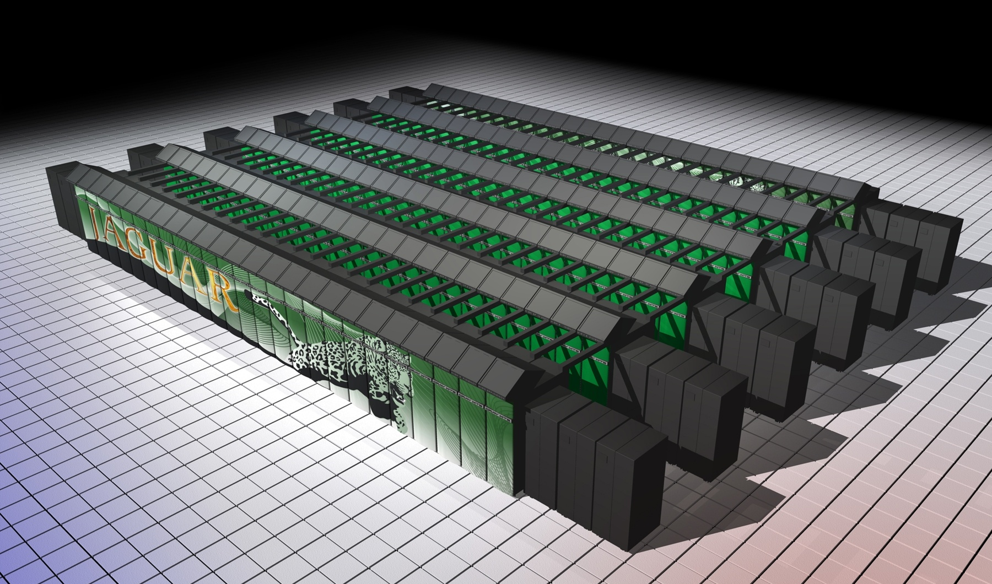
ORNL Petaflop System

Slide 27
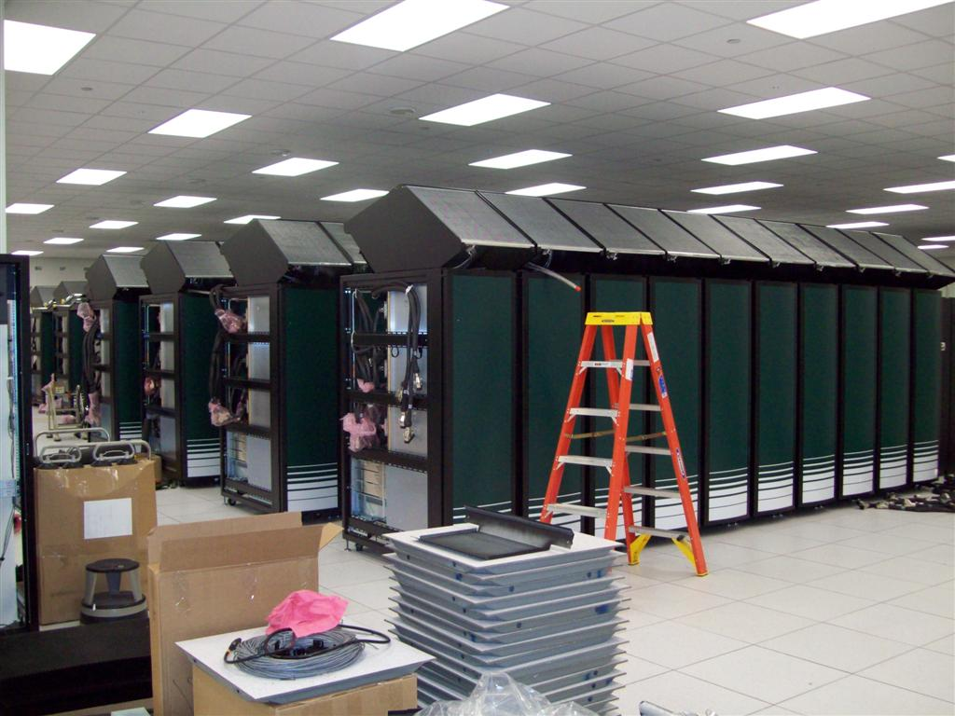

Slide 28
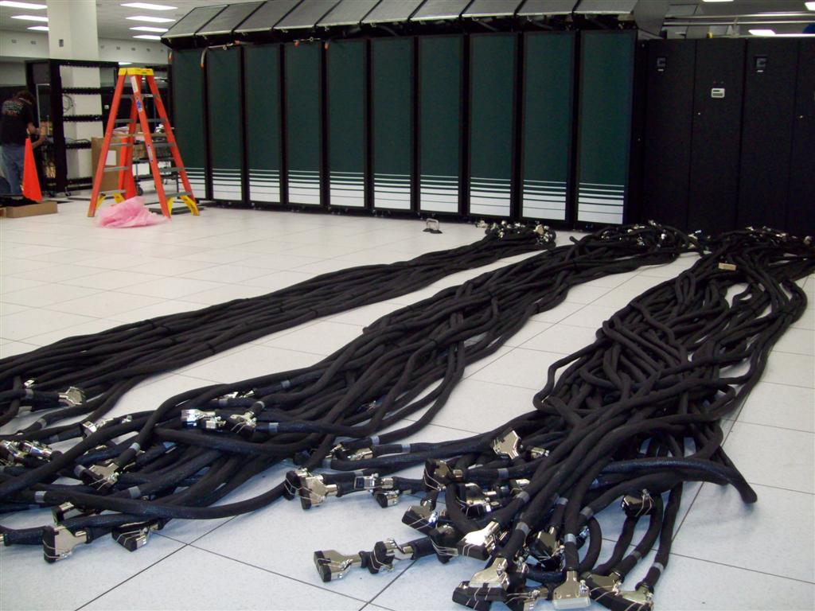
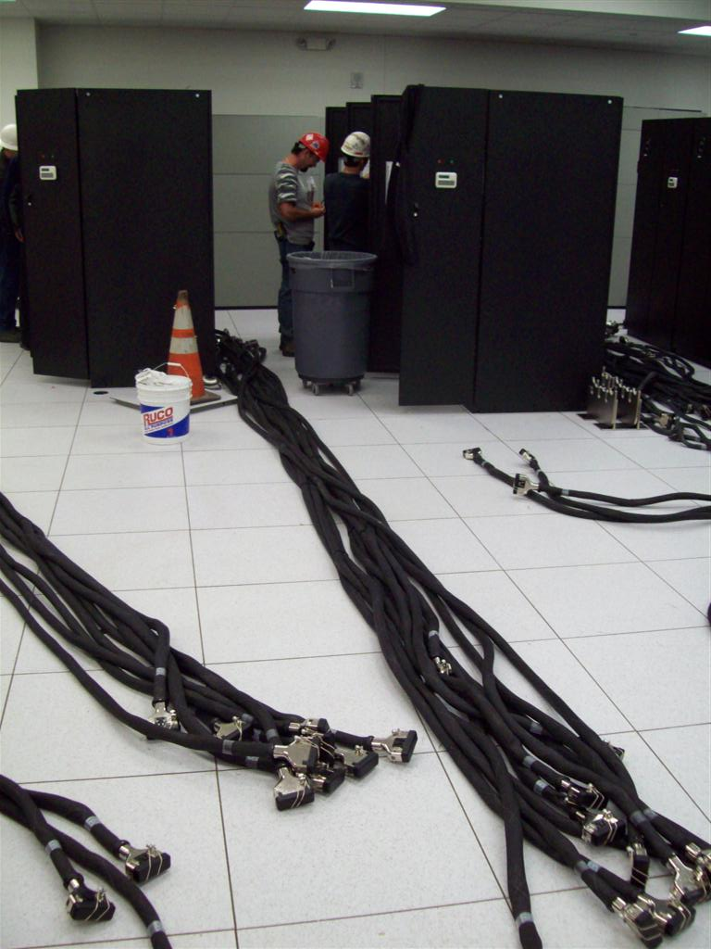
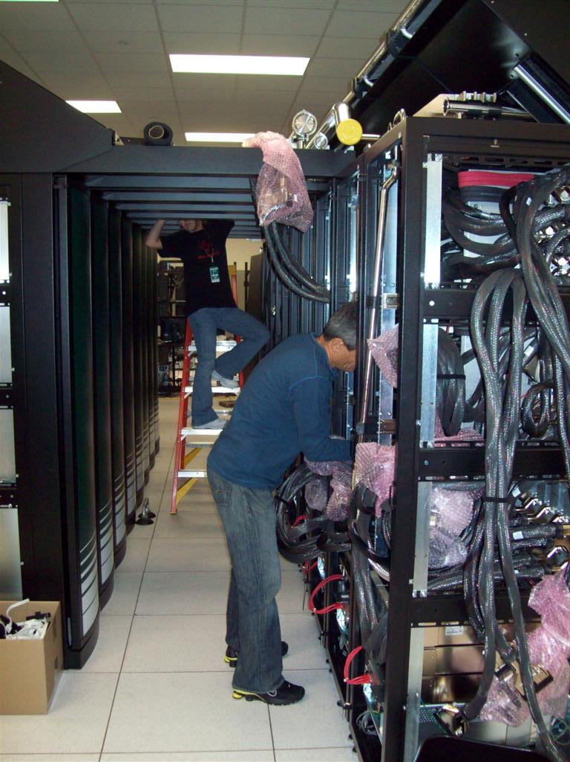
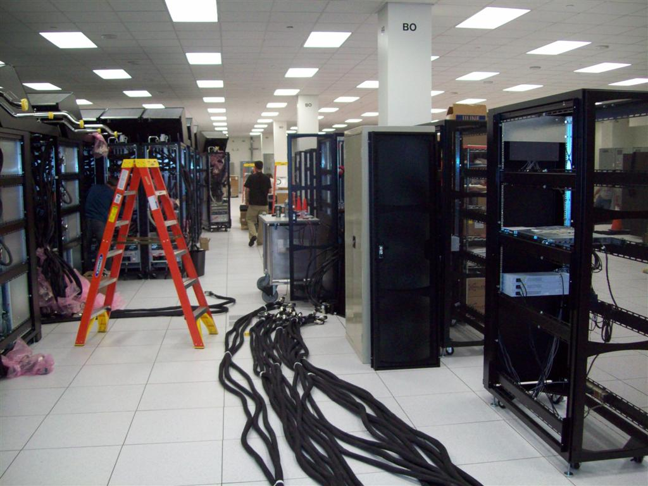
Cabling
7M
Anacondas

Slide 29
Pioneering Application: CHIMERA
Code Readiness, Scalability, and Performance
Readiness Activities
Physical Models
  Alpha network
Algorithms
  Spherical polar coordinate singularity workaround
  Poisson solver
Scalability & performance
  Multi-core ray-by-ray solves
  Replace domain decomposition from slab to pencil
  Parallel I/O
  Joule metric benchmark studies
MVH3 strong scaling (speedup vs core count) for a Sedov-Taylor blast wave on a 500³ mesh.
Scalability/Performance
Good weak and strong scaling
Initial Barcelona quad-core testbed performance promising
  Currently using 1 MPI task/core, with plans to implement OpenMP for threading of transport and nuclear burning solves
LCF liaison contributions
Implementing efficient, collective I/O
Pencil decomposition of 3D flow algorithm
Preconditioning of the neutrino transport equation
Notes:
Generally, we will use one MPI task per core up to quad core (and for the T2O runs). But, immediately after that, we do plan to move to hybridizing CHIMERA by using OpenMP.
2 of the heads will be threaded: The transport solve (both the Jacobian build and the preconditioner will be threaded; in fact, a threaded preconditioner for
the system we already have in hand). Remember that the transport solve is "local" to a single MPI task (i.e. many, independent transport solves are done at once
in multiple MPI tasks), so this threading just exposes parallelism that hasn't been exposed before in CHIMERA.
The nuclear burning will be threaded radial zone-wise: The burning occurs in each spatial zone, independent of the rest. We will simply thread this loop over
radial zones in each MPI task. This we might even do soon, i.e. before the T2O, with the alpha network solves. Other possibilities to expose parallelism here also exist,
but this 'simple' way seems obvious.
When mCHIMERA becomes bCHIMERA, we will have to use 1 MPI task/socket (we need the memory) and rely more on threads.

Slide 30
Pioneering Application: GTC
Code Readiness, Scalability, and Performance
Readiness Activities
Physical Models
  Implement split-weight scheme for kinetic electrons in shaped plasma component (GTC-S)
Algorithms
  Port and optimize GTC-S
Scalability & performance
  Implement radial and particle domain decomposition in GTC-S
  Implement asynchronous I/O
  Data flow automation
  Joule metric benchmark studies
Scalability/Performance
Excellent full system weak scaling with ~20% of peak performance realized
  Parallelized with MPI and OpenMP
Initial Barcelona quad-core testbed performance promising
  OpenMP threads perform well
  Reduced memory B/W may not be an issue
Needs to vectorize better
LCF liaison contributions
Asynchronous I/O
Automated end-to-end workflow
Porting/scaling new shaped plasma version

Slide 31
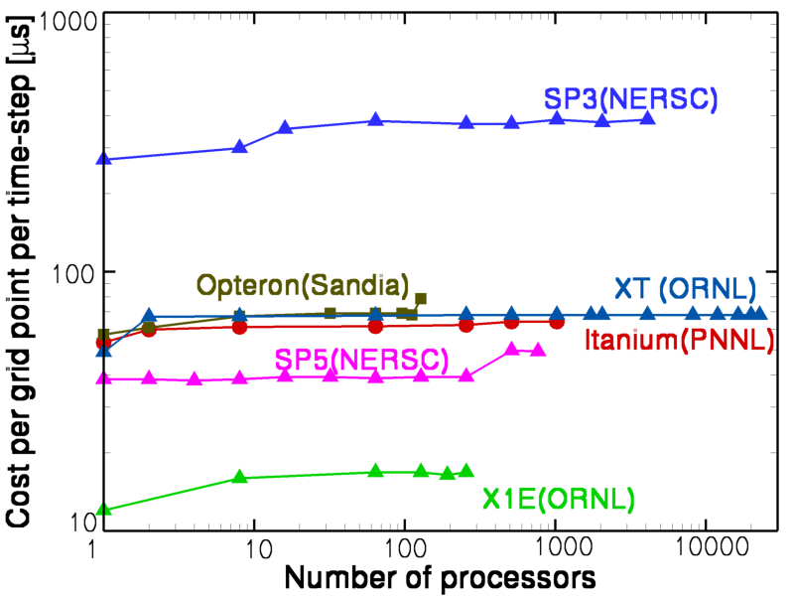
Pioneering Application: S3D
Code Readiness, Scalability, and Performance
Readiness Activities
Physical Models
  Develop reduced chemical mechanism for n-heptane and ethylene; developed reduced efficient transport model
Algorithms
  Test n-heptane model for stiffness; develop additive RK integration scheme if stiffness limits integration time step
  Implement massless Lagrangian tracers
Scalability & performance
  Tune multi-core performance
  Develop and test collective I/O
  Finalize run parameters (e.g. spatial resolution, domain size)
  Joule metric benchmark studies
Scalability/Performance
Excellent full system weak scaling with ~15% of peak performance
Initial Barcelona quad-core testbed performance promising
  Good vectorization
  Reduced memory B/W may not be an issue
  Addition of OpenMP threads still of interest
Efforts of SciDAC-PERI and Cray COE @ ORNL helpful
LCF liaison contributions
Implement Lagrangian tracers
I/O rework with NW University
Scaling studies identified processors burdened by memory corrections

Slide 32
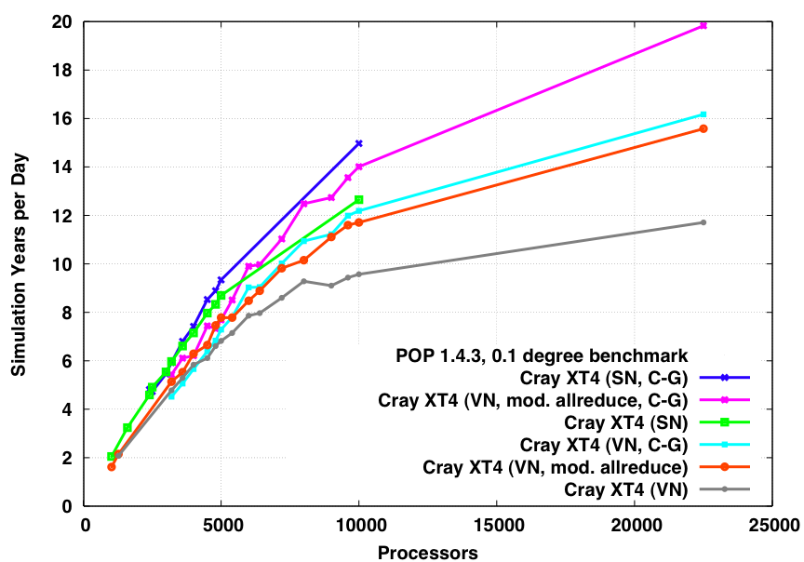
Pioneering Application: POP
Code Readiness, Scalability, and Performance
Readiness Activities
Algorithms
  Implement more scalable barotropic solver with improved CG preconditioner
    Block Jacobi (additive Schwartz), with plans for multi-level enhancement
    Trade extra flops for more iterations
Scalability & performance
  Tune for SSE and OpenMP parallelism
  Implement parallel I/O and test
Scalability/Performance
Ever-improving strong scaling with ~10% of peak performance
  Tackle scalability-limiting barotropic solver dominated by MPI all-reduce latency with new block Jacobi preconditioner
  Should benefit more from QC SSE instructions
New preconditioner in barotropic solve is 1.78x faster on 15,000 cores
  Full benchmark 1.38x faster
Initial Barcelona quad-core testbed perf
  Good vectorization
  Memory B/W an issue unless high processor counts are used to ensure small subgrid size
  Improved speedup needed w/ OpenMP threads
Addition of biogeochemistry creates more independent work, improving scalability
Issue with global gather for I/O on CNL
  Currently being addressed in multiple ways
LCF liaison contributions
New preconditioner for barotropic solver
Contributed bug fixes to POP 2.0
Represent needs at OBER/ESNET meeting
Notes:
Scalability limited by barotropic solver
Dominated by MPI all-reduce latency
Implemented new preconditioner
Block Jacobi
Trades extra flops for fewer iterations
Barotropic solve 1.78x faster on 15,000 cores
Full benchmark 1.38x faster
Should benefit more from quad-core SSE instructions

Slide 33
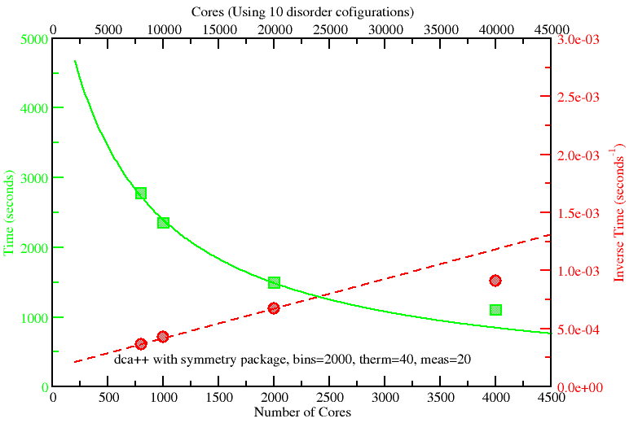
Pioneering Application: DCA++
Code Readiness, Scalability, and Performance
Readiness Activities
Physical Models
  Develop space group package for 2D/3D symmetry
  Develop multi-band Hamiltonian concept and DFT
Algorithms & Software
  Rewrite current QMC/DCA code
Scalability & performance
  Implement additional parallelization over disorder configurations (order 10² )
  Additional parallelizable loop over disorder configuration lies between the outer most self-consistency loop of the DCA and the Monte Carlo sampling loop
  Enables ~10 disorder configurations in parallel on a total of up to 20K cores
    Assuming individual QMC runs scale to 2000 cores at near optimal speedup
Scalability/Performance
Good weak scaling
Single-node performance relies on efficient execution of DGEMM on long thin rectangular matrices
Time to solution and speedup (inverse time) for a prototype DCA++ run of the 2D Hubbard model with 16 sites, 80 time slices, and 40,000 measurements, and two steps of MC updates between measurements
Notes:
Note that the upper scale in the figure assumes that we do the loop over disorder configurations. There is not going to be a bandwidth problem and I don't think we will have a latency problem either. This is why we assume that this loop will scale perfectly. If it is needed, we can demonstrate this toward the end of the month.

Slide 34
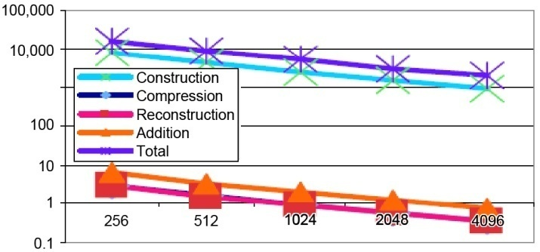
Pioneering Application: MADNESS
Code Readiness, Scalability, and Performance
Readiness Activities
Dynamic load-balancing
  Testing data redistribution
  Commencing development on work stealing
Multi-core
  Testing design choices for threading of task queue
Applications
  Density functional theory – migrating from prototype to implementation
  Dynamics – evaluating new time evolution scheme
Scalability/Performance
Runtime objective: scalability to 1+M processors ASAP
Runtime responsible for
  scheduling and placement,
  managing data dependencies,
  hiding latency, and
  Medium to coarse grain concurrency
Compatible with existing models
  MPI, Global Arrays
Borrow successful concepts from Cilk, Charm++, Python
Performance examples
  Small matrix BLAS in x86 assembly
    Tuned for target problems
    2-6x faster than existing libraries (ACML, ATLAS, Goto, MKL)
    50-87% of theoretical peak FLOP/s speed
  Parallel scalability
    Tested for correctness and performance on 4096 cores under CNL. Also functions on BG

Slide 35
Current Planned Pioneering Application Runs
Cursory Look at the Simulation Specs
Code | Quad-Core Nodes | Global Memory Reqm (TB) | Wall-Clock Time Reqm (hours) | Number of Runs | Local Storage Reqms (TB) | Archival Storage Reqms (TB) | Resolution and Fidelity
CHIMERA | 7824 4045 | 16 8 | 100 100 | 1 1 | 13 | 50 | 256x128x256 or 256x90x180 20 energy groups, 14 alpha nuclei
GTC-S GTC-C | 3900 3900 | 40 60 | 36 36 | 2 2 | 350 | 550 | 600M grid points, 60B particles 400M grid points, 250B particles
S3D | 7824 | 10 | 140 | 1 | 50 | 100 | 1B grid points, 15 μm grid spacing 4 ns time step, 23 transport vars
POP | 2500 | 1 | 400 | 1 | 1 | 2 | 3600x2400x42 tripole grid (0.1°) 20-yr run; partial bottom cells; first with biogeochemistry at this scale
MADNESS | 7824 | 48 | 12 2 | 10 12 | 5 | 50 | 600B coefficients
DCA++ | 2000 6000 | 16 48 | 12 to 24 | 20 | 1 | 1 | Lattices of 16 to 32 sites 80 to 120 time slices O(10²-10³) disorder realizations
Astrophysics – Fusion – Combustion – Climate – Chemistry – Materials Science
Notes:
600Million grid points, 60 billion particles
400 Million grid points, 250 billion particles.

Slide 36
What’s wrong with HPL & HPCC
HPL is only measuring Peak Flops
HPCC measures everything
  Only two of vendors in the June 2008 Top 100 has submitted HPCC.
    IBM and Cray
  No non-custom interconnect system over 128 nodes have been submitted
To get high percentage of peak, one must use all the memory available, which means longer running time, which quickly becomes a MTTF test
Once accelerators are 64 bit capable, they will dominate the Top 500, because they can use fewer faster processors
Maybe we should require all Top 500 entries should come from HPCC

Slide 37
 | Manufacturer | Interconnect | Processor Count |  |  | Cores per Chip | HPL Processes | Threads |  | MPI Processes
 |  |  | Total | from Form | Derived |  |  | from Form | from Code
2006-04-06 | IBM | Custom | 65536 | 65536 | 65536 | 1 | 65536 | 1 | 1 | 65536
2005-11-02 | IBM | Custom Torus / Tree | 131072 | 131072 | 65536 | 1 | 65536 | 1 | 1 | 65536
2005-11-02 | IBM | Custom Torus / Tree | 131072 | 131072 | 65536 | 1 | 65536 | 1 | 1 | 65536
2005-11-02 | IBM | Custom Torus/Tree | 65536 | 65536 | 65536 | 1 | 65536 | 1 | 1 | 65536
2005-11-04 | IBM | Blue Gene Custom Interconnect | 40960 | 32768 | 32768 | 2 | 32768 | 1 | 1 | 32768
2007-11-06 | Cray Inc. | Seastar | 12960 | 12960 | 25920 | 2 | 25920 | 1 | 1 | 25920
2006-11-10 | Cray Inc. | Cray custom | 12960 | 12960 | 25920 | 2 | 25920 | 1 | 1 | 25920
2006-11-10 | Cray Inc. | Cray custom | 12960 | 12960 | 25920 | 2 | 25920 | 1 | 1 | 25920
2007-11-06 | Cray Inc. | Seastar | 12960 | 12800 | 25600 | 2 | 25600 | 1 | 1 | 25600
2005-11-04 | IBM | Blue Gene Custom Interconnect | 40960 | 32768 | 16384 | 2 | 16384 | 1 | 1 | 16384
2006-11-06 | Cray Inc. | Cray SeaStar | 10424 | 10404 | 10404 | 2 | 10404 | 1 | 1 | 10404
2006-11-06 | Cray Inc. | Cray SeaStar | 10424 | 10404 | 10404 | 2 | 10404 | 1 | 1 | 10404
2006-01-11 | Cray Inc. | Seastar | 10368 | 10350 | 10350 | 1 | 10350 | 1 | 1 | 10350
2005-11-04 | IBM | HPS | 10240 | 10240 | 10240 | 1 | 10240 | 1 | 1 | 10240
2008-05-14 | Cray Inc. | Cray Seastar | 8608 | 8464 | 8464 | 4 | 8464 | 1 | 1 | 8464
2006-08-02 | IBM | HPS | 12288 | 8192 | 8192 | 1 | 8192 | 1 | 1 | 8192
2005-11-09 | IBM | HPS | 8192 | 8192 | 16384 | 1 | 8192 | 2 | 2 | 8192
2007-04-09 | Cray Inc. | Cray Seastar | 8192 | 8190 | 8190 | 2 | 8190 | 1 | 1 | 8190
2005-11-12 | Cray Inc. | Cray Seastar | 5212 | 5208 | 5208 | 1 | 5208 | 1 | 1 | 5208
2005-11-12 | Cray Inc. | Cray Seastar | 5212 | 5208 | 5208 | 1 | 5208 | 1 | 1 | 5208
2005-11-10 | Cray Inc. | Cray Seastar | 5212 | 5208 | 5208 | 1 | 5208 | 1 | 1 | 5208
2005-11-10 | Cray Inc. | Cray Seastar | 5212 | 5208 | 5208 | 1 | 5208 | 1 | 1 | 5208
2005-08-01 | Cray Inc. | Cray XT3 MPP Interconnect | 5200 | 5200 | 5200 | 1 | 5200 | 1 | 1 | 5200
2005-11-13 | Cray Inc. | Seastar | 4178 | 4128 | 4128 | 1 | 4128 | 1 | 1 | 4128
2005-09-19 | Cray Inc. | Cray XT3 MPP Interconnect | 4096 | 4096 | 4096 | 1 | 4096 | 1 | 1 | 4096
2005-06-21 | Cray Inc. | Cray XT3 MPP Interconnect | 3748 | 3744 | 3744 | 1 | 3744 | 1 | 1 | 3744
2007-12-19 | SGI | InfiniBand | 512 | 512 | 2048 | 4 | 2048 | 1 | 1 | 2048

Slide 38


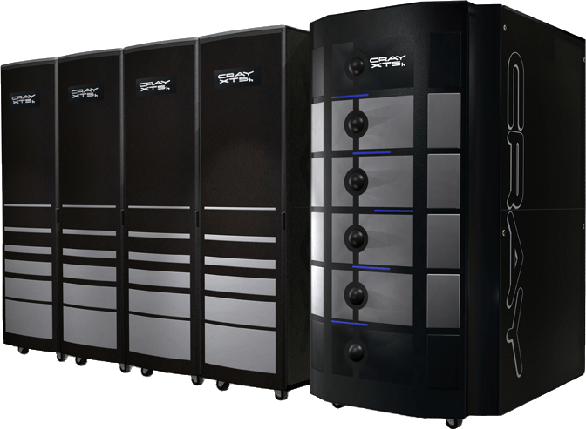
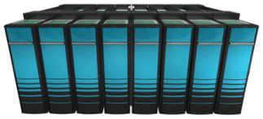
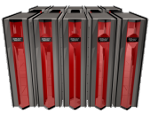
The Cray Roadmap
Realizing Our Adaptive
Supercomputing Vision
“Granite”
“Baker”+
“Marble”
“Baker”
2011+
Cascade Program
Cray XT5 & XT5_{h}
2010
2009
Cray XT4
Cray XMT
Scalar
2008
Vector
Multithreaded
9/14/2008
Slide 38
9/14/2008
Notes:
Cray’s Roadmap for Today
Vector Computer is no longer sold separately
Most Cray Clients Buy Systems with Only Scalar Processors
Cray Proprietary
38

Slide 39

Cray Cascade Project
Cray High Productivity Computing Systems
Scalable, High-Bandwidth Interconnect (Aries)
Granite
Custom
Compute
Node
Granite
Custom
Compute
Node
Granite
Custom
Compute
Node
Granite
Custom
Compute
Node
Granite
Custom
Compute
Node
Granite
Custom
Compute
Node
Marble
x86
Compute
Node
Marble
x86
Compute
Node
Marble
x86
Compute
Node
Marble
x86
Compute
Node
Marble
SIO
Node
Marble
SIO
Node
Globally Addressable Memory
Support for PGAS and DGAS Data Distributions
Local
Memory
Local
Memory
Local
Memory
Local
Memory
Local
Memory
Local
Memory
Local
Memory
Local
Memory
Local
Memory
Local
Memory
Local
Memory
Local
Memory
Tightly integrated hybrid computing
Configurable network, memory, processing and I/O
Globally addressable memory
Very high performance communication and synchronization

Slide 40
Path Forward
Decreasing Required human power with Excellent
Compilers
Fewer nodes with Accelerators
Usable
Accelerators
Cray Inc
Multi-core
Nodes
Adaptive
Computing
2008
2009
2010
Decreasing Required System power without sacrificing performance
Many low power nodes

